Slide 1
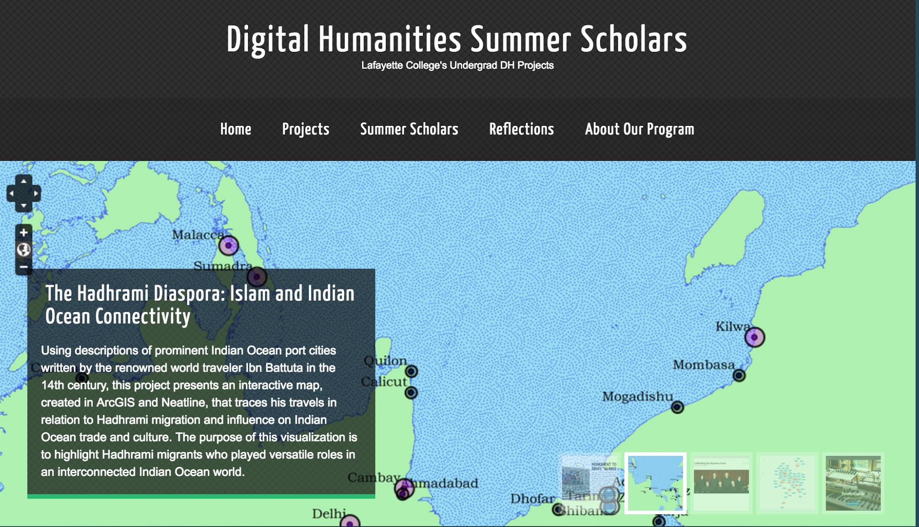
Digital Humanities Summer Scholarship
A Model for Undergraduate Engagement in DH

Slide 2
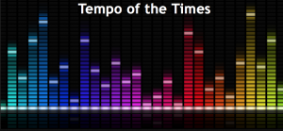
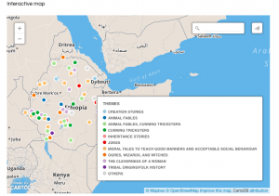
Years 1 & 2
Year 1: 7 Scholars, wide range of projects, conversations within DH community, tool-centric, project-centric. Successful!
Year 2: 8 Scholars, more research-intensive, started earlier, scaffolded in librarians, professors, and grounded projects in arguments.
Tempo of the Times
This project was developed in hope of discovering connections between music and society. Artists set out to create music that entertains, but also look to create art that represents the times in which they live. This project looks to examine the way in which societal changes shift musical composition. – Vincent DeMarco and Benjamin Draves
Got Folktales?
This project aims to capture Ethiopian folktales and map out reoccurring themes as well as to highlight the moral behind each folktale. In order to accurately represent the diverse ethnicities found within the country we have selected five stories from each of the 13 regions within the country-Feevan Megersa

Slide 3
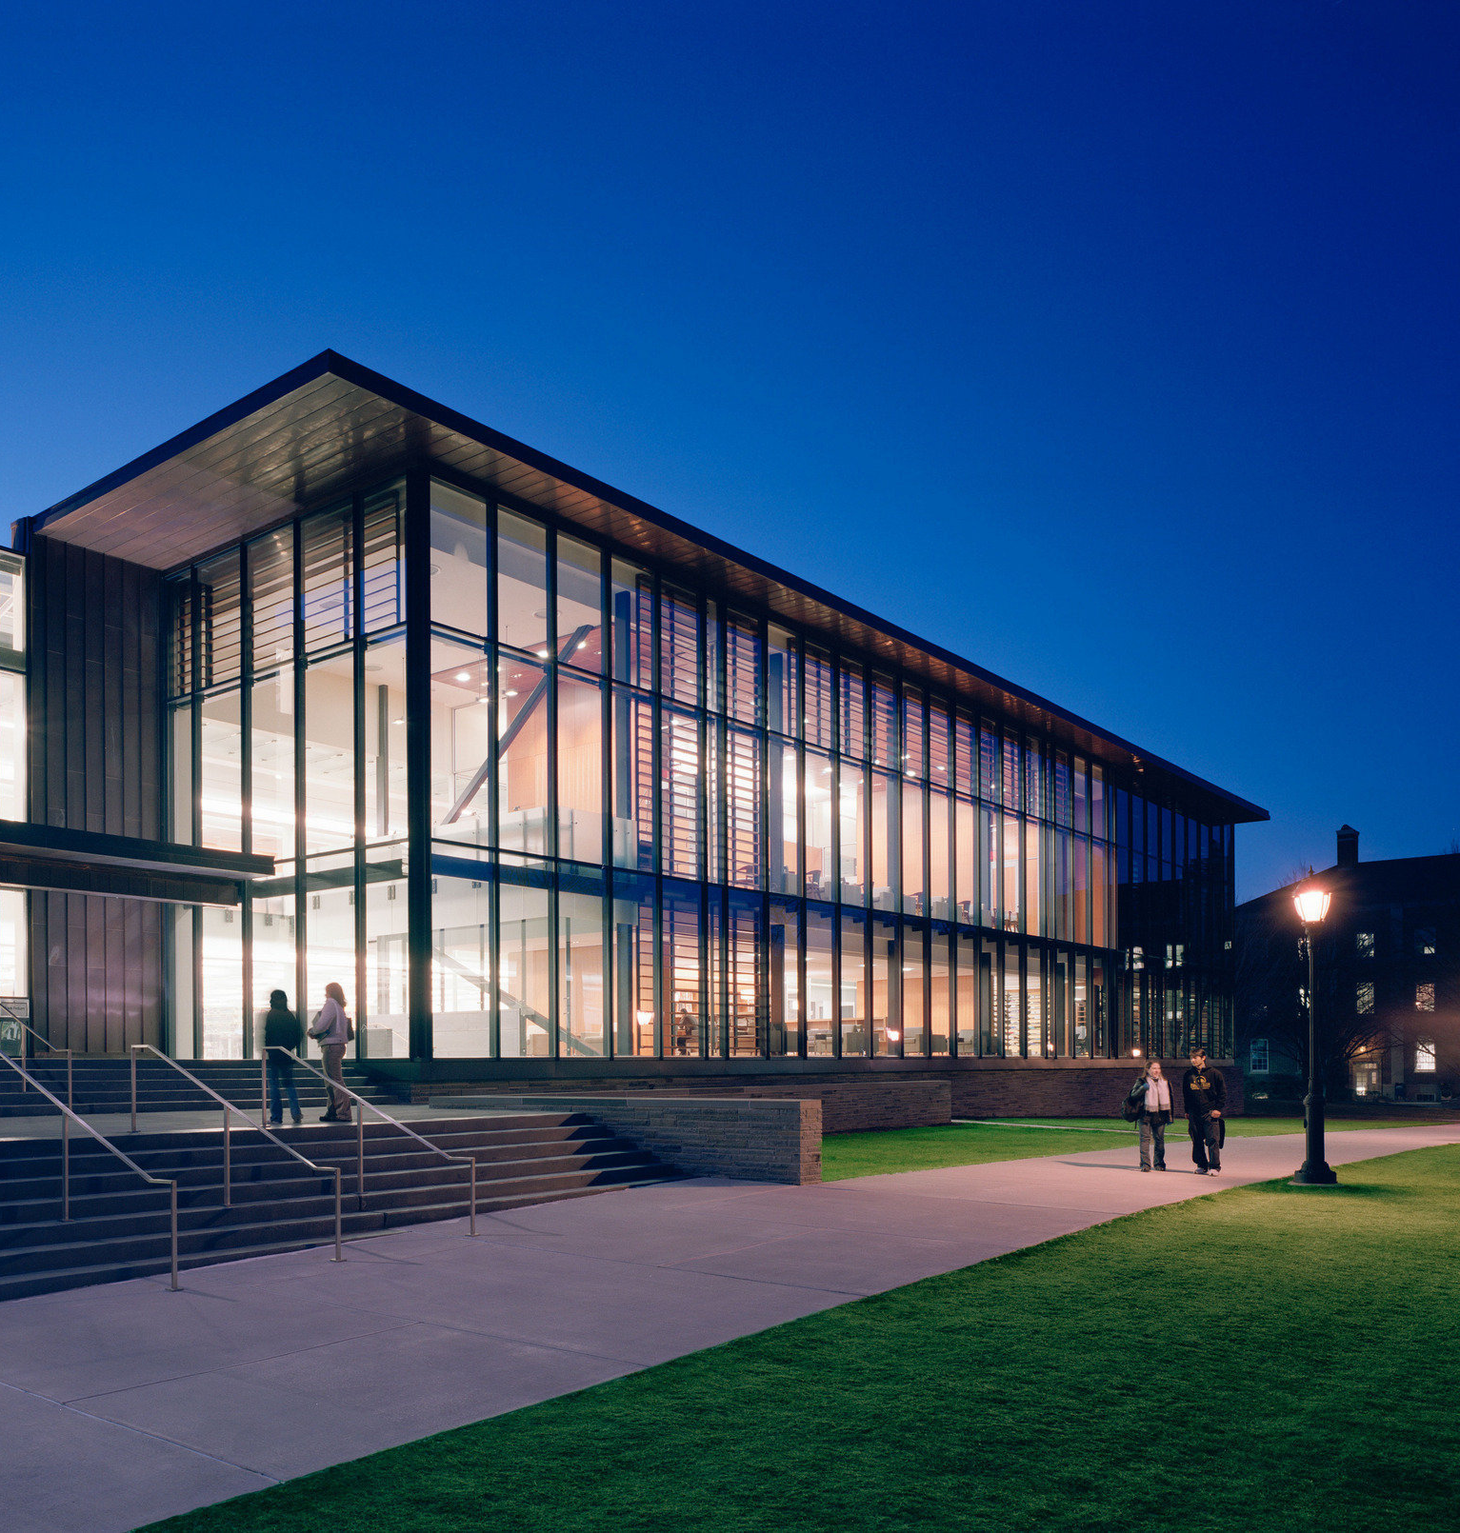
Nuts and Bolts
-Met twice a week with a lab
-Three Component Parts + Assing:
(1) Research Process (T)
Proposal, thesis (with project included), annotated bibliography, lit review, methodology, analysis, conclusion. Entire draft 1, draft 2, final paper.
(2) Project Building
Digital Humanities definitions, digital project review, tool review, tool demo, project draft 1, final project, presentations
(3) Reflection

Slide 4
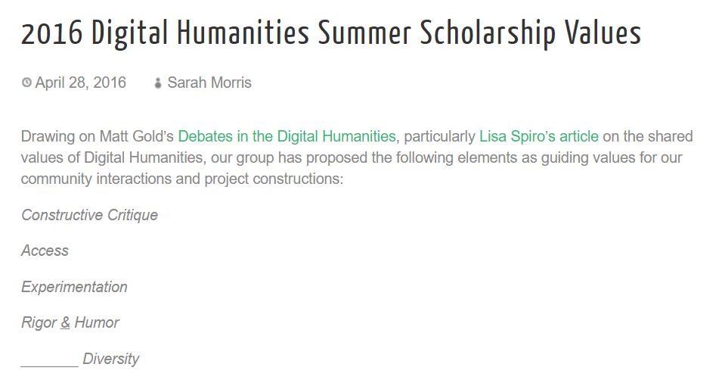

Slide 5
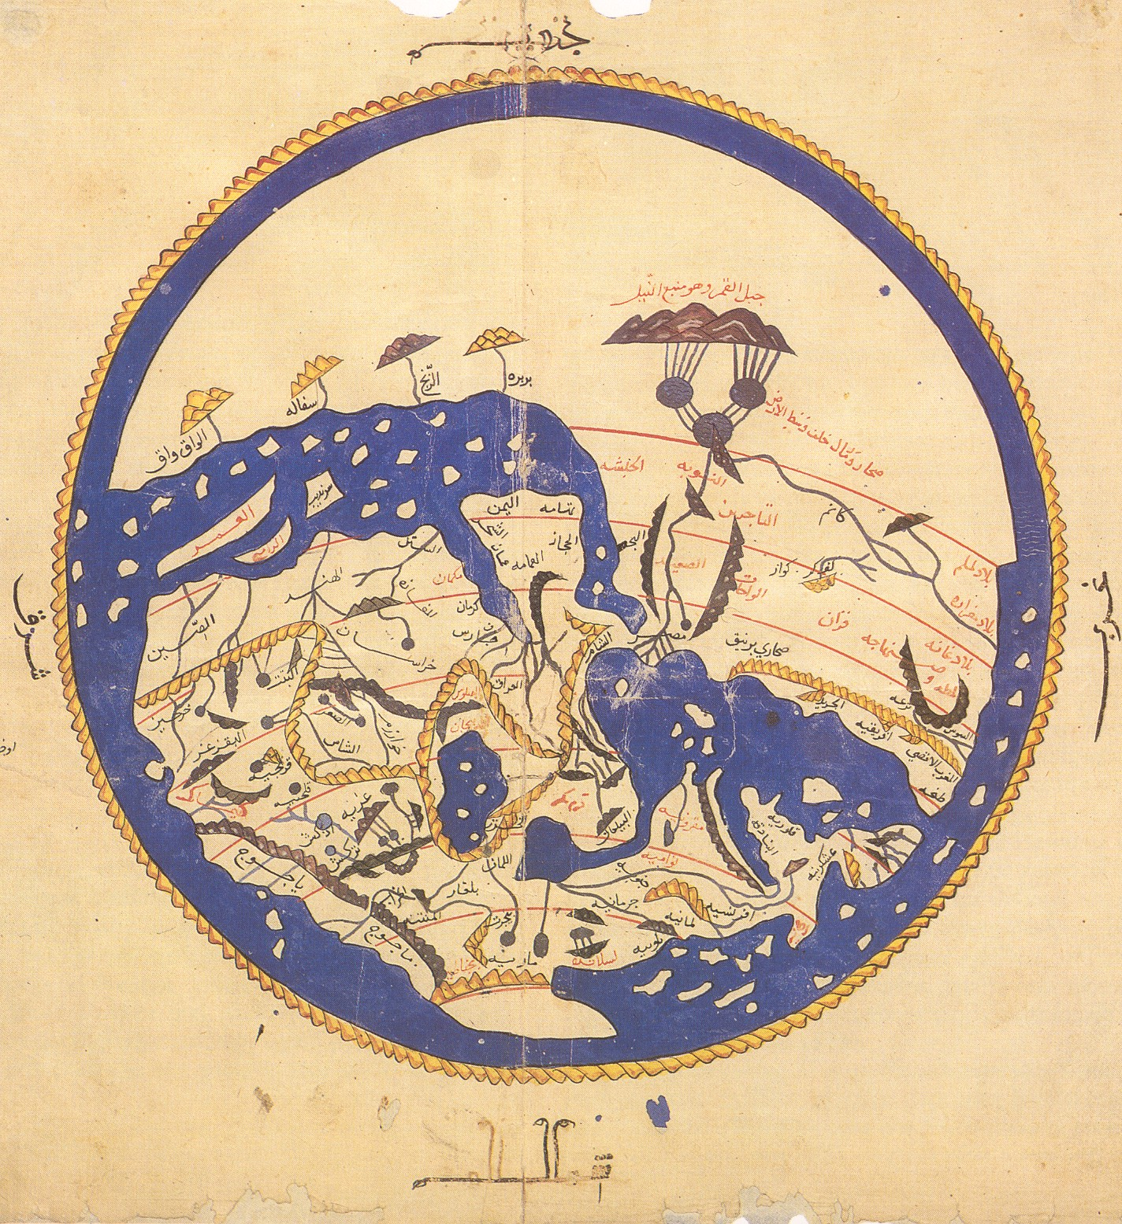
Alternate Cartographies
Al-Sharif al-Idrisi,
World Map, 1154

Slide 6
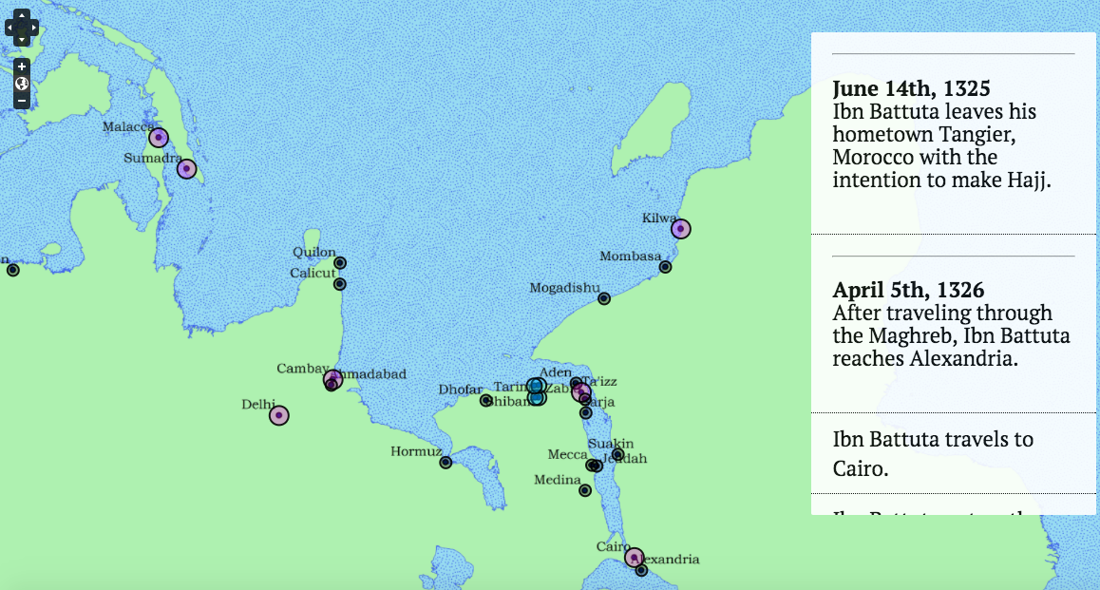
The Hadhrami Diaspora

Slide 7
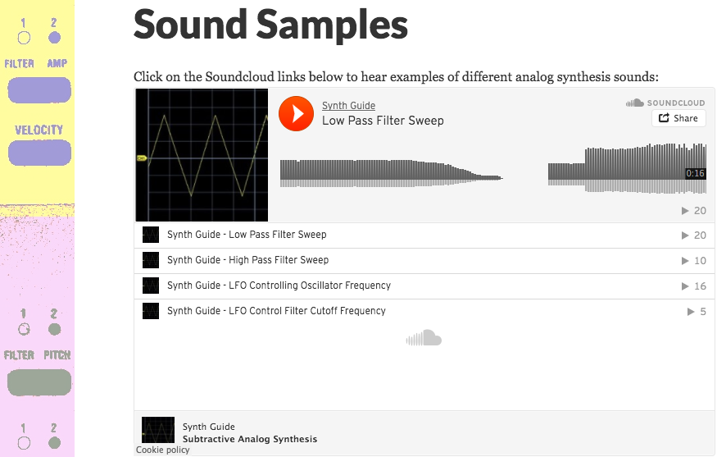
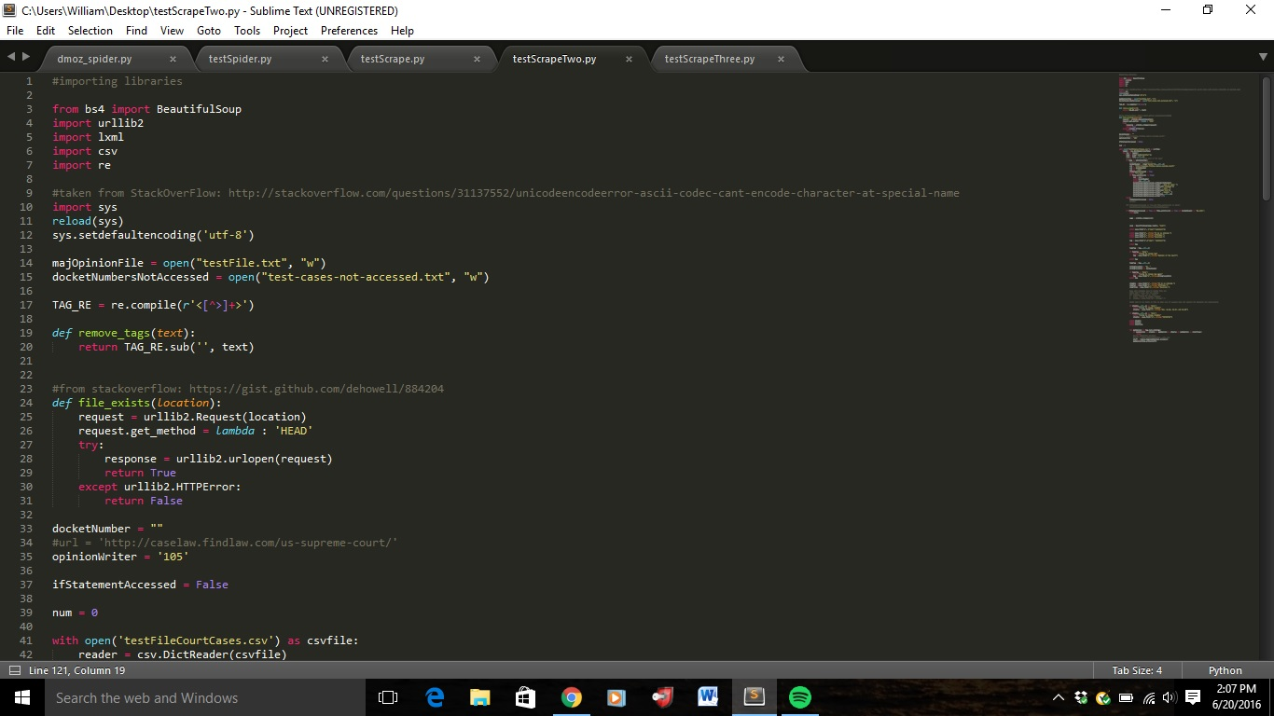

Slide 8
“Scholarship is a strange endeavor, the foremost knowledge one gains from it is the realization of how severely one lacks it.” –Abdul
“Overall, all the failures I had during this program were not really failures. I don’t think there was ever a time that I didn’t learn something that if not immediately applicable would help me in the long-run academically and also in life.” –Tawfiq

Slide 9
“Narrowing my topic was painful, but necessary. After realizing the amount of research I would have to do just to do a narrowed version of the project I originally envisioned, I was already stressed. But more importantly, narrowing an idea to something that one will be able to do quality and sufficient research on is essential to learn. In order to do a project right, one has to do justice to the scholarly research that came before, and that would be much, much more difficult with a larger scope. It is imperative to understand these limits and judge time frames realistically when approaching problems so one can plan ahead and realize the work he or she must do.” –Will

Slide 10
“But I realize, six weeks later, that I needn’t have spent those nights in the company of a database, accompanied by a lingering sense of doubt. I should have turned towards myself, instead, and questioned my own intentions. Why had I allowed myself to accept the notion that my first research ideas should be the pillars upon which I would build an empire? Unlike the monuments that I was to examine, I was not made of stone. No. As a human being, I was meant to be swayed by the winds of change, for change is what fuels progress, and progress is what ultimately leads to growth.” –Mila

Slide 11
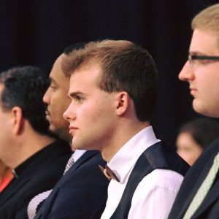
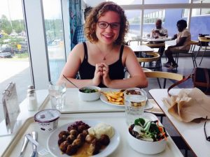
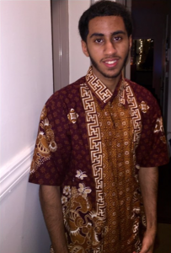
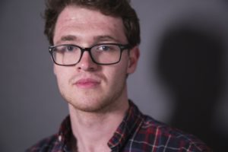
sites.lafayette.edu/dhss
For detailed projects, research, reflections, and more, check out our site.
Learn more about our projects at the digital poster session today.

